Slide 1

Optimizing Pathfinding Algorithms for Real-World Applications: A Comparative Study
NAME : Deekshitha Chowdary Kalluri
COURSE: CIS 730 - Artificial Intelligence
DATE: 5/14/2025

Slide 2
INTRODUCTION
What is Pathfinding?
Pathfinding refers to determining the shortest or most efficient route between two points.
It is crucial in fields like robotics, navigation, video games, and logistics.
Why Is This Important?
Fast and efficient pathfinding saves time and resources.
Poor pathfinding can lead to slow or failed operations in real systems.
Project Goal
Compare five well-known pathfinding algorithms under the same environment.
Understand their strengths, weaknesses, and best-use scenarios.

Slide 3
STATEMENT
Objective of the Project
Implement and compare five pathfinding algorithms: A*, Dijkstra’s, IDDFS, Beam Search, and Hill Climbing.
Test them on random 2D grids with obstacles.
Key Questions
How fast is each algorithm?
Do they return the shortest path?
Are they reliable across various maps?
Metrics Measured
Execution time (in seconds)
Path length (number of steps)

Slide 4

ALGORITHMS
A*
Combines path cost and heuristic estimate.
Optimal and efficient when heuristic is admissible.
Dijkstra’s Algorithm
Similar to A* but uses no heuristic.
Finds shortest paths but explores more nodes.
IDDFS
Combines DFS memory usage with BFS completeness.
Often revisits nodes, making it slow and inefficient.
Beam Search
Keeps top-k nodes at each level.
Trades completeness for speed and memory efficiency.
Hill Climbing
Always moves to the neighbor closest to the goal.
Fast but often fails due to local minima.

Slide 5

METHODOLOGY
Environment Setup
10x10 grid with 20% of cells randomly blocked as obstacles.
Start: top-left corner (0,0)
Goal: bottom-right corner (9,9)
Manhattan distance used as the heuristic.
Implementation
Python 3 in Google Colab.
Used NetworkX for graph structure.
Algorithms modularized for easy testing.
Experiment Design
Each algorithm tested on the same 50 randomly generated maps.

Slide 6
METRICS
Path Length
Measures how many steps the agent takes to reach the goal.
Execution Time
Runtime of each algorithm (measured using time.perf_counter()).
Success Rate
Whether the algorithm successfully returned a path.
Especially relevant for algorithms like Hill Climbing.

Slide 7
EXPERIMENT SETUP
Tools Used
Python 3 in Google Colab.
NetworkX for graph creation.
Matplotlib for plots and visualization.
Conditions
All algorithms ran on identical maps.
No bias in starting positions or goal configurations.
Results averaged over multiple runs.

Slide 8
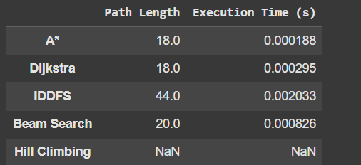
RESULTS
A* and Dijkstra give shortest paths.
Beam Search trades optimality for speed.
IDDFS is inefficient but complete.
Hill Climbing often fails.

Slide 9
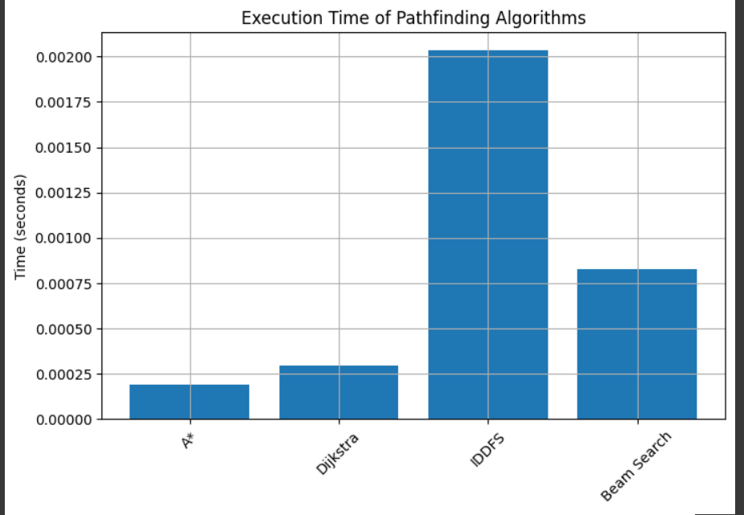
EXECUTION TIME
Insight
A* is the fastest optimal method.
Dijkstra’s is slower due to exhaustive search.
IDDFS is slowest.
Beam Search is relatively fast.
Hill Climbing is fast when it works — but it often fails.

Slide 10
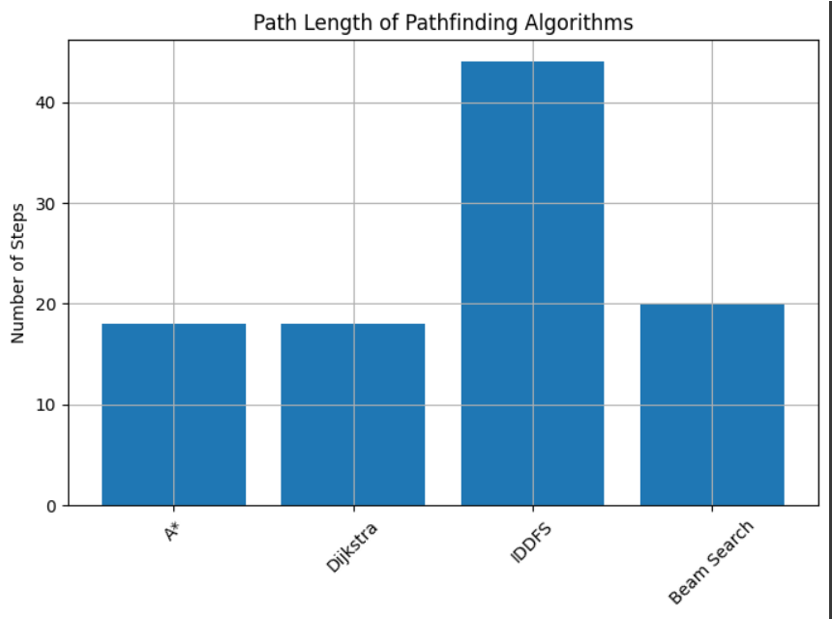
PATH LENGTH
Insight
A* and Dijkstra produce the shortest paths (18 steps).
Beam Search paths are slightly longer (~20).
IDDFS has inefficient paths (avg. 44 steps).
Hill Climbing not shown due to frequent failure.

Slide 11
OBSERVATIONS
A* is the best in both speed and accuracy.
Dijkstra is useful but slower.
Beam Search can be a good trade-off when memory or time is limited.
IDDFS is inefficient due to revisiting.
Hill Climbing is unreliable and often fails.

Slide 12

CONCLUSION
Conclusion
Classical algorithms behave differently in obstacle-filled environments.
A* is the best all-around performer.
Not all algorithms are suited for real-world tasks.
Future Work
Test on larger, weighted graphs (e.g., OpenStreetMap).
Introduce dynamic obstacles.
Add machine learning or reinforcement learning agents.
Use neural networks for learned pathfinding.

